Slide 1


Slide 2
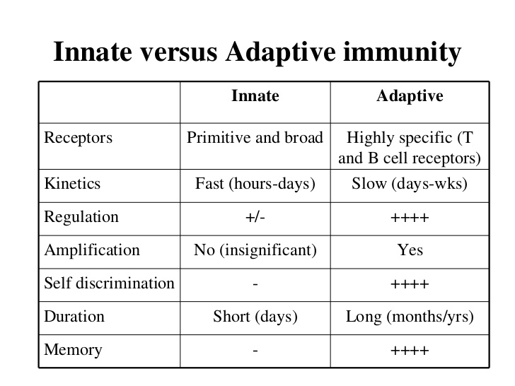

Slide 3







Adaptive Immunity
Functionally, an immune response consist of two interrelated events : recognition of antigen and response to that antigen. These different type of immune response falls into two categories:
Immune response
Innate Immunity
Adaptive Immunity
In this tutorial Immunity.
you will
explore
the knowledge
of Adaptive

Slide 4













Functions of Adaptive immunity
Adaptive Immune system
1
Destroy invading pathogens and any toxic molecules they produce.
2
Highly specific to the particular pathogen that induced them.
The innate responses call the adaptive immune responses into play, and both work together to eliminate the pathogens.
3
Provide long-lasting protection. A person who recovers from measles, for example, is protected for life against measles by the adaptive immune system.
4
The ability to distinguish what is foreign from what is self is a fundamental feature of the adaptive immune system.
5

Slide 5













Cells involved in Adaptive Immunity
Cells involved in Adaptive Immune
response
Antigen-presenting cells
Lymphocytes
Macrophages
B lymphocytes (B cells)
T lymphocytes (T cells)
B cells
Dendritic cells

Slide 6












Lymphocytes
Some points to remember about lymphocytes:
1.
Bone marrow
Hematopoiesis
Lymphocytes (a type of white blood cell)
Mature lymphocytes after leaving primary lymphoid organs circulate through blood, lymph and peripheral lymphatic tissues.
Lymphocytes produce and display antigen-binding cell surface receptors.
Lymphocytes are further classified as B-lymphocytes or B-cells and T-lymphocytes or T-cells.

Slide 7
B-lymphocytes (B-cells)
B-lymphocytes (B-cells): Lymphocytes arise in the bone marrow; out of these, the cells which mature in the bone marrow itself are called as B-cells.
After maturation within the bone marrow, B-cells leave the marrow expressing a unique antigen-binding receptor on their membrane.
The B-cell receptor is a membrane-bound antibody molecule.
B-cells are inactive before exposure to an antigen. These are called as ‘naïve B-cells’.
Upon activation, B-cells specific for the antigen proliferate into memory cells and antibody secreting effector cells or plasma cells.

Slide 8











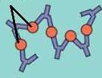

Maturation & development of B-cells
B-cells originate in bone marrow
Antigen
T_{H}-Cell
Pro-B cell
Pre-B cell
Immature B-cell
Naive B-cell
Active B cell
Pluripotent stem cell
Bone marrow lymphocyte
Antigen Destruction
Antibody secretion
Plasma Cell
Memory cell

Slide 9
T-lymphocytes (T-cells)
T-lymphocytes (T-cells): The lymphocytes which migrate to another primary lymphoid organ, thymus and mature there are termed as T-cells.
During its maturation within the thymus, the T cell comes to express a unique antigen-binding receptor on its membrane, called the T cell receptor (TCR).
TCRs can only recognize antigen that is associated with cell membrane proteins known as Major Histocompatibility Complex (MHC) molecules.
Cytotoxic T-cells defend against infected (viruses, bacteria), diseased, self altered like tumor cells and transplanted tissues.

Slide 10











T-lymphocytes (T-cells)
T-lymphocytes
T_{H} cells
T_{C} cells
Express
Express
CD4 glycoproteins
CD8 glycoproteins
on their surfaces
on their surfaces
Thus, acquired immunity is composed of activated
CD4 (T_{H}) and CD8 (T_{C}) cellular responses.

Slide 11

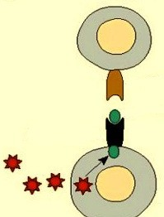
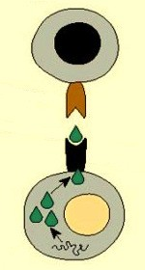
T-Lymphocytes
CD4⁺ T-cells
T_{H} cells recognize foreign proteins or antigens that have been
Antigen specific T-cell receptor
processed through
an by
exogenous pathway
Antigen
antigen-presenting cells
(APCs) such as dendritic cells
MHC class-II
in lymph nodes, macrophages or B-cells expressing Major
Histocompatability Complex
Exogenous pathway
(MHC) class-II molecules.
CD8⁺ T-cells
Antigen specific T-cell receptor
T_{C} recognize processed endogenous presented transformed
antigens that are
an and
or
through pathway
by infected
Antigen
MHC class-I
cells expressing
MHC class-I molecules.
Endogenous pathway

Slide 12













T-lymphocytes (T-cells)
T-lymphocytes
T_{H} cells (CD4)
T_{C} cells (CD8)
Exogenous pathway
Endogenous pathway
MHC-II molecules Expressed by APCs
MHC-I molecules Expressed by nucleated cells

Slide 13

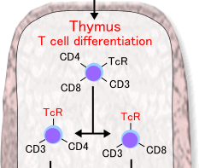

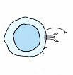

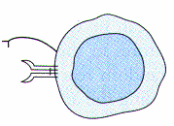
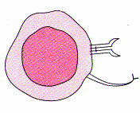
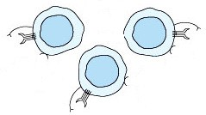
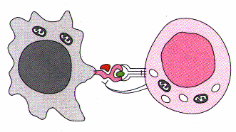




Maturation & development of T-cells
Blood stream
Immature pre T-cells
Bone marrow
Memory T_{H} cell
Enters peripheral blood circulation
Mature T_{C}
cell
APC
Mature T_{H} cell
Effector T_{H} cell
Release cytokines
Memory T_{C} cell
CTL
Destruction

Slide 14
Humoral and Cell mediated immune response
There are two broad classes of adaptive immune responses— antibody responses or Humoral immune responses and cell- mediated immune responses.
The responses carried out by B-lymphocytes are termed as Humoral immune responses. And those carried out by T- lymphocytes are termed as cell-mediated immune responses.
Humoral immune responses are best suited for the elimination of exogenous antigens; whereas cell mediated immune response is best suited for the elimination of endogenous antigens.

Slide 15
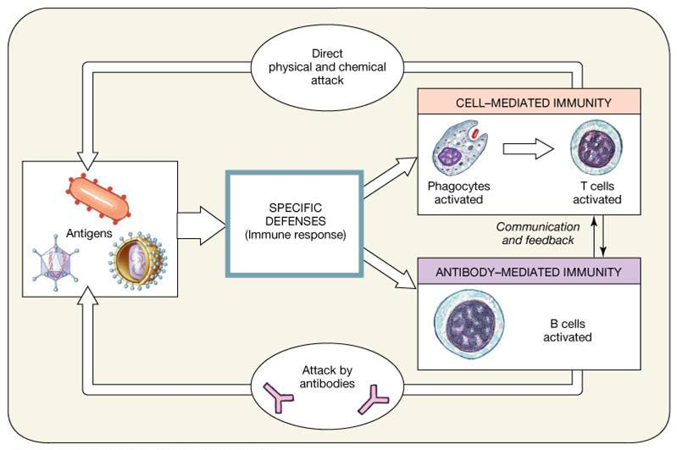

Slide 16
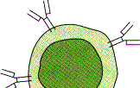






Humoral immune response
In humoral responses, B-cells are activated to secrete antibodies.
The antibodies circulate in the bloodstream and permeate the other body fluids, where they bind specifically to the foreign antigen that stimulated their production.
+
T_{H}-cell cytokines
Release
B-cell
Antigen
Plasma cell Antibodies
Binding of antibody inactivates viruses and microbial toxins (such as tetanus toxin or diphtheria toxin) by blocking their ability to bind to receptors on host cells.
Antibody binding also marks invading pathogens for destruction, mainly by making it easier for phagocytic cells of the innate immune system to ingest them.

Slide 17
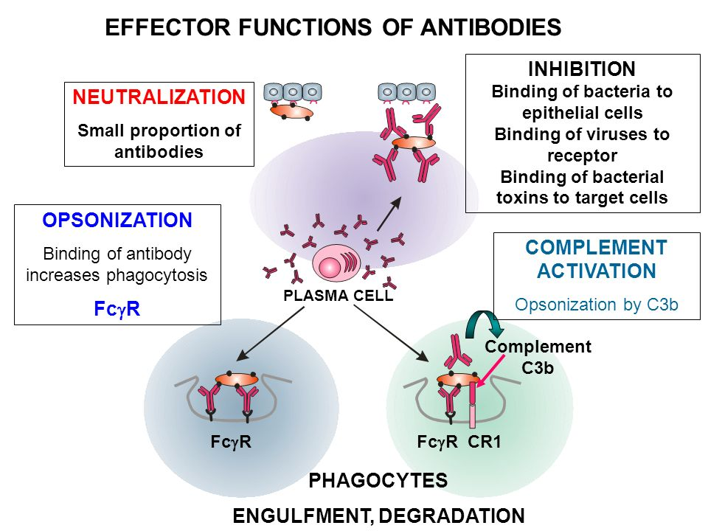

Slide 18
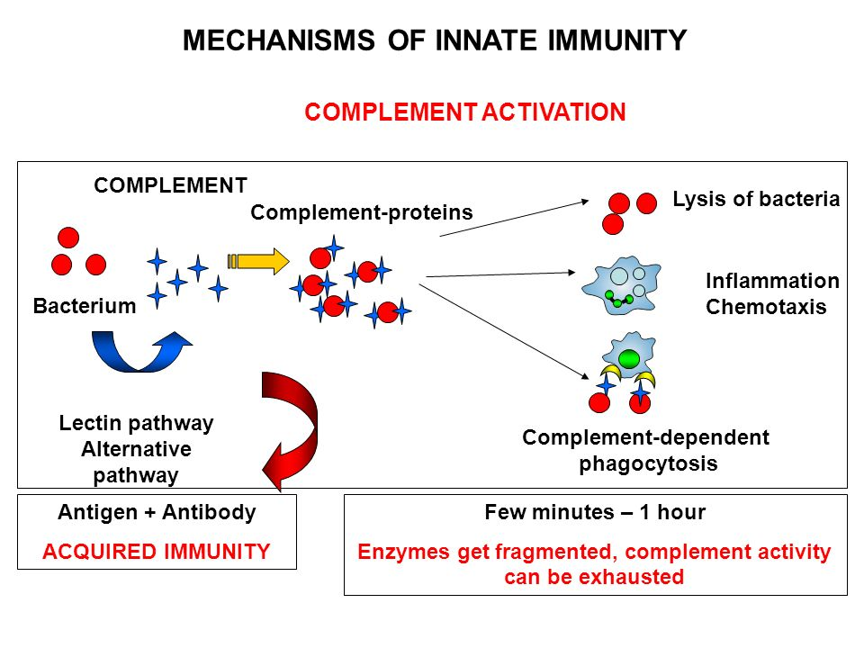

Slide 19



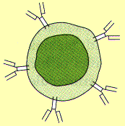
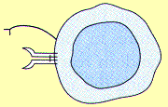
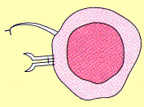
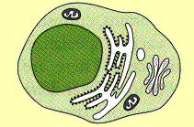
Humoral and Cell mediated immune response
Antigens
Foreign proteins
viruses
Bacteria
Parasites
Fungi
Attack host
Trigger immune response
Humoral immune response
Cell mediated immune response
Carried out by B-cells
Carried out by T-cells
+
Ag
T -cell
T_{C}-cell
Activated T -cell
H
H
MHC class- II molecules
MHC class- I molecules
Plasma cell
Release antibodies
 | Activated T_{H}-cell
Release of cytokines
Activated T_{C}-cell
Effectors of humoral immune response
Kill self altered cells

Slide 20
Cell mediated immune response
The second class of adaptive immune response is cell-mediated immune (CMI) response.
In this, activated T cells react directly against a foreign antigen that is presented to them on the surface of a host cell. CMI responses are carried out by T_{H} cells and T_{C} cells.
Cell mediated immune response
Carried out by T-cells
T_{H}-cell
T_{C}-cell

Slide 21
Cell mediated immune response
The T cell, for example, might kill a virus-infected host cell that has viral antigens on its surface, thereby eliminating the infected cell before the virus has had a chance to replicate.
In other cases, the T cell produces signal molecules that activate macrophages to destroy the invading microbes that they have phagocytosed.

Slide 22
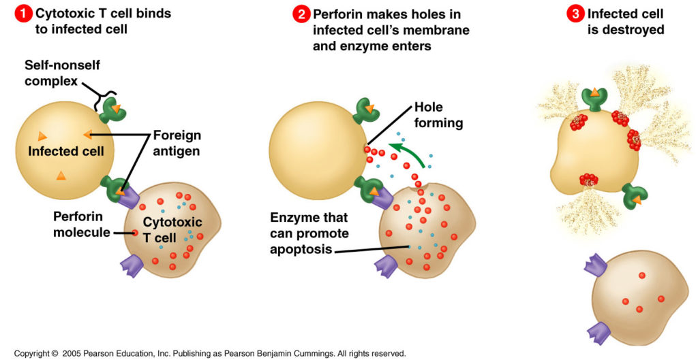

Slide 23
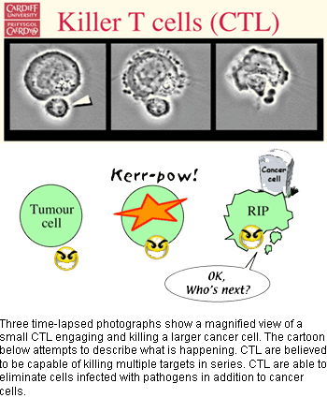

Slide 24
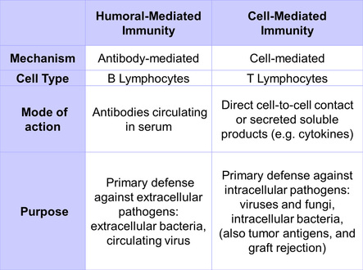

Slide 25
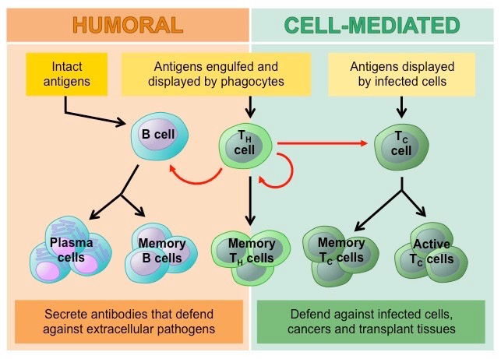

Slide 26











Adaptive Immunity
Adaptive (specific ) Immunity – The resistance that an individual acquires during life is known as adaptive or acquired immunity. It is capable of recognizing and selectively eliminating specific foreign microorganisms and molecules.
Adaptive immunity is of two types:
Adaptive Immunity
Active immunity
Passive immunity

Slide 27












Active and Passive Immunity
Active immunity is the resistance developed by an individual as a result of an antigenic stimulus. This involves the active functioning of person’s
Active immunity
immune system leading to the
synthesis of antibodies and/or the production of immunologically active cells. Active immunity sets in only after a latent period which is required for the immunological machinery to be set in motion.
Adaptive Immunity
The resistant that is transferred to a recipient in a readymade form is known as passive immunity. Here the recipient’s immune system plays no active role. There is no
Passive immunity
antigenic preformed
stimulus; antibodies
instead,
are
administered.

Slide 28
Adaptive & Innate Immunity
Difference between Active & Passive Immunity
Active Immunity Passive Immunity
Sr. No.
1
Produced actively by the host’s immune system.
Received passively by the host. No participation by the host’s immune system.
2
Induced by infection or by
Conferred by introduction of
contact with immunogens.
readymade antibodies.
3
Affords durable and effective protection.
Protection is transient and less effective.
4
Immunity effective only after a lag period (time required for generation of antibodies).
Immunity effective immediately.

Slide 29
Adaptive & Innate Immunity
Difference between Active & Passive Immunity
Sr. No. | Active Immunity | Passive Immunity
5 | Immunological memory present. Subsequent challenge more effective (Booster effect). | No immunological memory. Subsequent administration of antibody less effective due to immune elimination.
6 | ‘Negative phase’ may occur. | No negative phase.
7 | Not applicable in immunodeficient hosts. | Applicable in immunodeficient hosts.

